Slide 1

2023
PROVIDER MEETING

Slide 2
AGENDA
Welcome
Vision & Mission
Journey
What’s New
What’s Ahead
Lunch

Slide 3
Mission
Our world is constantly changing; thereby, creating challenges to overcome and opportunities for personal development and growth.
Our mission is to Enable our Partners to Meet People Where They Are to Provide a Personalized Counseling and Coaching Experience in a Welcoming and Relatable Atmosphere.

Slide 4
Vision
Establish Ourselves as The Recognized Partner of Choice for Clinical and Education Professionals.

Slide 5
Journey
2019
No Office
1 Provider
2020
1 Location
1 Provider
2021
1 Location
3 Providers
2022
4 Offices
9 Providers
2023
6 Offices
26 Providers
1 Office
2 Offices
1 Location
3 Locations

Slide 6
What’s New
2023
Launch PCG Education
Enhanced Marketing
Simplified Billing
Enhanced Compensation Reports
New Training Resources
Client Referrals

Slide 7

What’s New
Tutoring and Home School Assistance

Slide 8




What’s New
Marketing: Social Media
Accounts
8
Posts
20 /Month
Followers
2500+

Slide 9
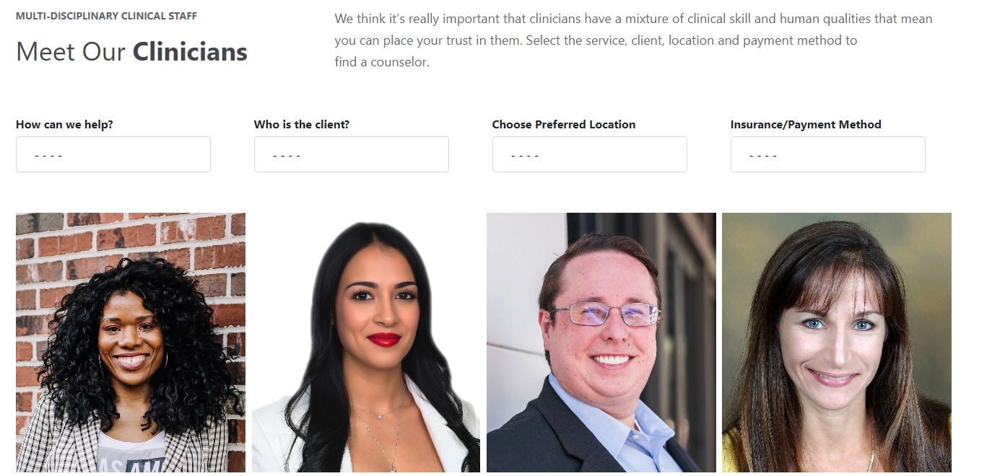
What’s New
Marketing: Website Client Routing

Slide 10
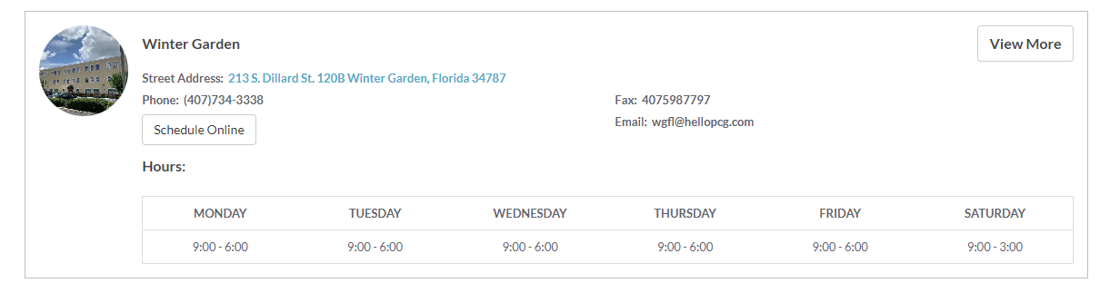

What’s New
Marketing: Website Client Routing

Slide 11





What’s New
Marketing: Print Templates

Slide 12
What’s New
Billing: Simplification
Plain Language Descriptions
Fewer Choices
Easier Online Scheduling

Slide 13
What’s New
Communication: Client Referrals – 3 Pathways
Client Contacts provider
Provider Connects to Client
Client Contacts Call Center
Call Center Connects to Provider
Provider Connects to Client
Client Contacts Call Center
Call Center Connects to Office
Office Connects to Provider
Provider Connects to Client

Slide 14

What’s New
Communication: Client Referrals
Client Contacts Call Center
Call Center Connects to Office
Office Connects to Provider
Provider Connects to Client
Specific Referral
Office Notifies Provider
Provider Connects to Client
General Referral
Office Notifies Provider Group
Available Provider Responds
Referral Assigned to Available Provider

Slide 15
What’s New
Compensation: Enhanced Reports
New Design
License and Insurance Expiration Dates
Client Balance Details
Open Invoice Details

Slide 16
What’s New
Training: New Resources
Monthly Zoom Training
Online Knowledge Base Articles
How To Documents
How To Videos

Slide 17
What’s Ahead
2024
8 Locations
16 Offices
2024
40 Providers
2024
Private Equity Offering
2025
5 States
2025
15 Locations
35 Offices
2025
50+ Providers
2025
Franchise Program

Slide 18
THANK YOU

Slide 19
LUNCH

